Slide 1

Travelers Case Competition
A Kangaroo Auto Insurance Company Modeling Problem
Zhong (Verse) He
Xin (Amy) Ni
Jun Sun
Julie Shih
12/1/2016
© Uconn School of Business
Notes:
Background/ Problem Statement: Using past Kangaroo Auto Claims data, we want to:
1) Build a model that predicts claim cost
2) Segment customers into risk categories

Slide 2
Problem Statement
Kangaroo, an Australian Auto Insurance Company would like to create a rating plan based on the historical auto claim data.
The Kangaroo data set is based on one-year vehicle insurance policies from 2004 to 2005. There are 67856 policies, of which 4624 (6.8%) had at least one claim.
For this case competition, your task is to provide a method for predicting the claim cost for each policy and provide business insights.
The model will be evaluated by GINI index.
12/1/2016
© Uconn School of Business

Slide 3
Objective : build a high accuracy predictive model and forecast the claim cost
Model 1
Model 2
Business
Value
12/1/2016
© Uconn School of Business

Slide 4
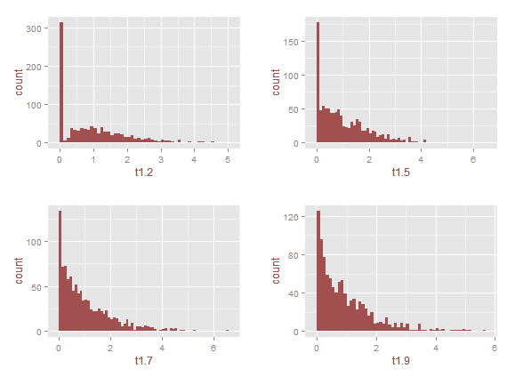
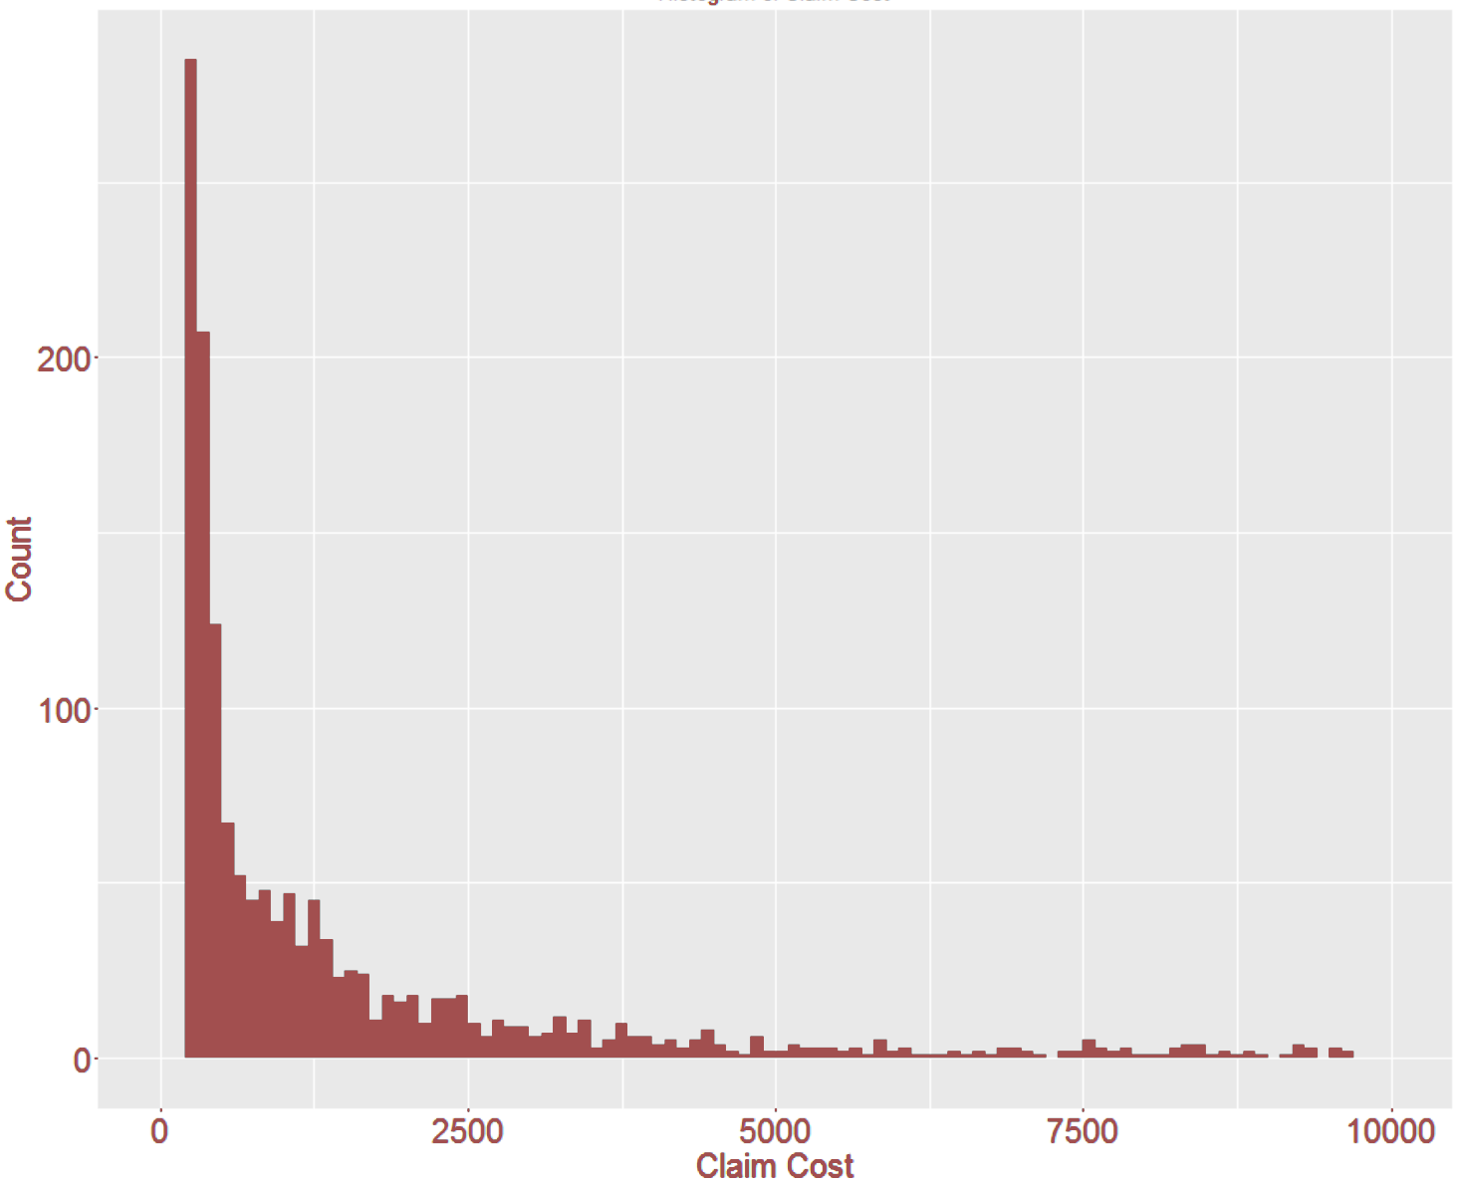
Model 1
Model 2
Business Value
Tweedie Distribution Our Distribution
Power: 1-2
Exclude 0 and extreme costs
12/1/2016
© Uconn School of Business
Notes:
Tweedie Distribution are a family of probability distributions including continuous normal distribution, continuous gamma distribution,discrete scaled Poisson distribution and mixed compound Poisson–gamma distributions.

Slide 5
Model 1
Model 2
Business Value
Compound Poisson Generalized Linear Model (CPGLM) with Tweedie
Convert categorical variables to numerical
Fit CPGLM with tweedie distribution
Adjusted tweedie parameters
Variable selection
Final model
12/1/2016
© Uconn School of Business
Notes:
https://www.casact.org/education/rpm/2012/handouts/Session_4734_presentation_1003_0.pdf
Assumes poisson frequency and gamma severity
CPGLM is used in actuarial statistics, more powerful than linear regression models in handling claims data which are:
Asymmetric
Have overdispersion
In-between gamma and poisson distribution
Used features: exposure, veh_age.1, agecat.1

Slide 6
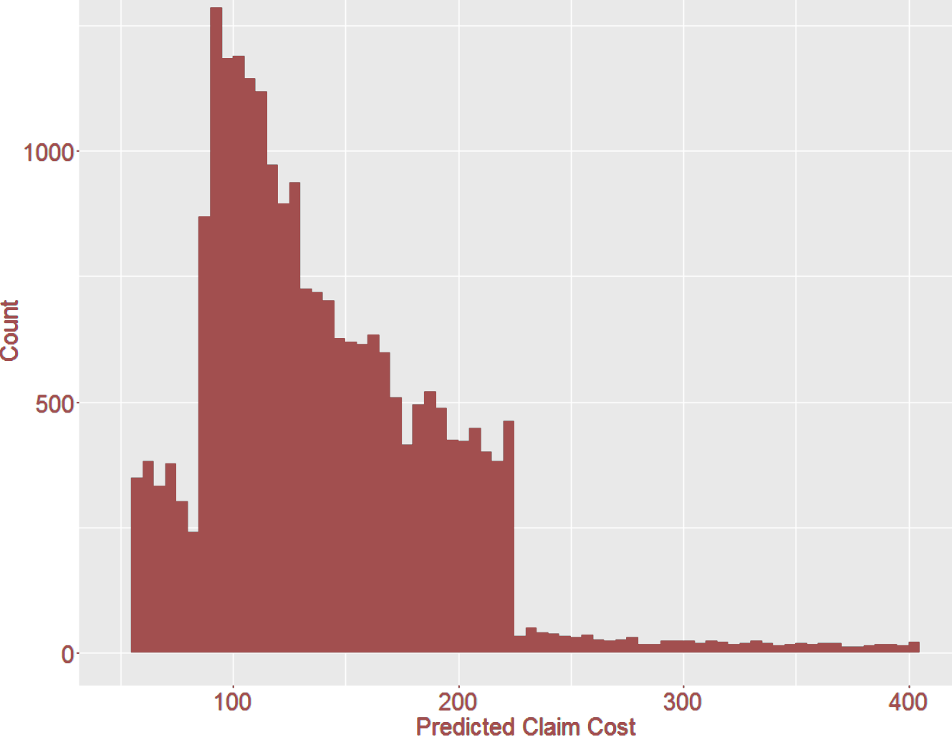
Model 1
Model 2
Business Value
Our key variables are exposure, vehicle age.1, and agecat.1
GINI = 0.2458
12/1/2016
© Uconn School of Business
Notes:
Predicted overall cost of claims $3,259,071
Actual overall cost of claims $3,757,814

Slide 7




There are four other variables we think could be useful.
Model 1
Model 2
Business Value
Annual Mileage
Maximum Coverage
&
Deductible
Claim History
Driving History (speeding tickets, etc)
12/1/2016
© Uconn School of Business
Notes:
http://www.21st.com/insurance-newsletters/2012/05/how-are-insurance-rates-determined.htm

Slide 8
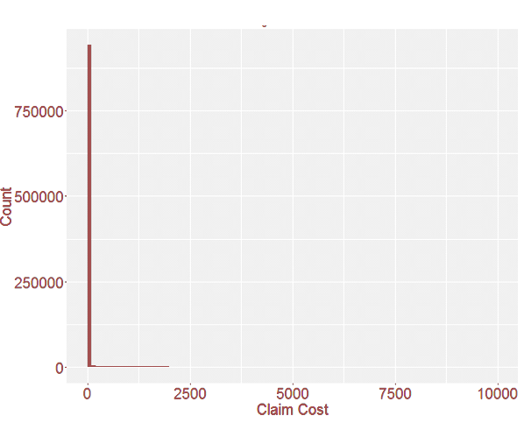
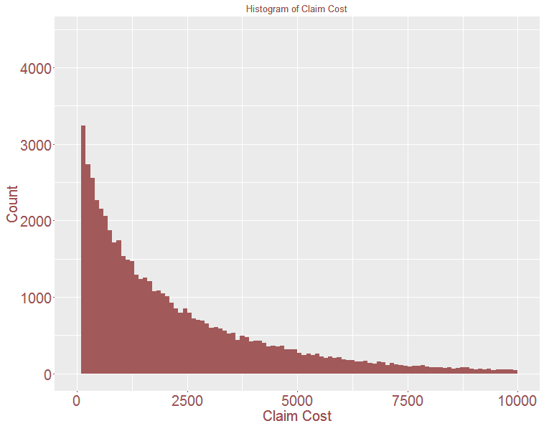
We reconstructed a tweedie distribution.
Model 1
Model 2
Business Value
Mean = 141
Power = 1.56
12/1/2016
© Uconn School of Business
Notes:
mu=141, power=1.56, phi=313
Predicted overall cost of claims $3,259,071
Actual overall cost of claims $3,757,814

Slide 9
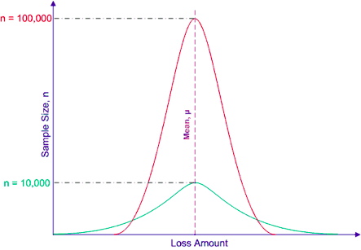
Although single events are random and unpredictable,
the average outcome of many similar events can be predicted.
Model 1
Model 2
Business Value
Our theoretical basis: the Law of Large Numbers
12/1/2016
© Uconn School of Business
Notes:
A statistical axiom that states that the larger the number of exposure units independently exposed to loss, the greater the probability that actual loss experience will equal expected loss experience.

Slide 10



Model 1
Model 2
Business Value
Law of Large Numbers Theory
12/1/2016
© Uconn School of Business

Slide 11
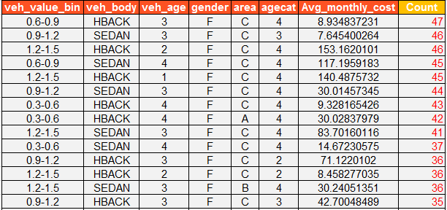
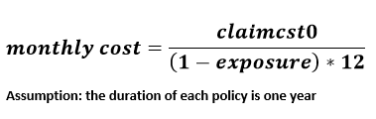
Model 1
Model 2
Business Value
Choose Segmentation Variables
Key variables from our model:
Exposure
Vehicle Age
Agecat
Area - not that significant
Our target variable:
12/1/2016
© Uconn School of Business

Slide 12
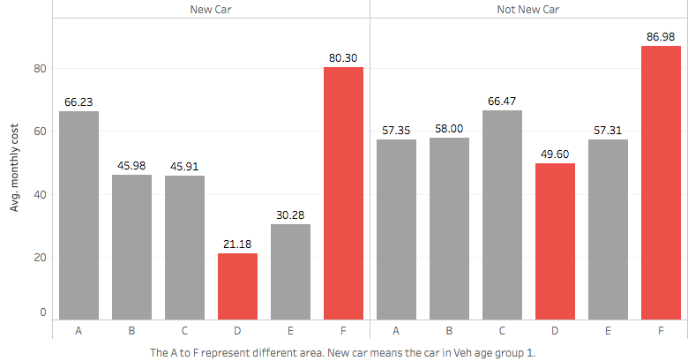
Model 1
Model 2
Business Value
Area D has lowest Avg. claim cost while area F has the highest.
Key Variables
Exposure
Vehicle Age
Agecat
Area
12/1/2016
© Uconn School of Business

Slide 13
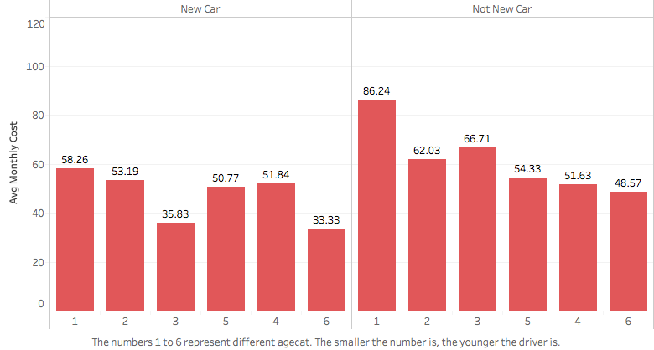
Model 1
Model 2
Business Value
The Avg. claim cost of new cars is lower than that of others.
Key Variables
Exposure
Vehicle Age
Agecat
Area
12/1/2016
© Uconn School of Business

Slide 14
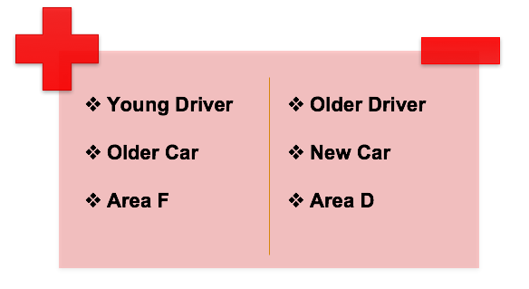
Model 1
Model 2
Business Value
Highest Avg.claim cost vs. lowest Avg.claim cost
12/1/2016
© Uconn School of Business

Slide 15


Slide 16
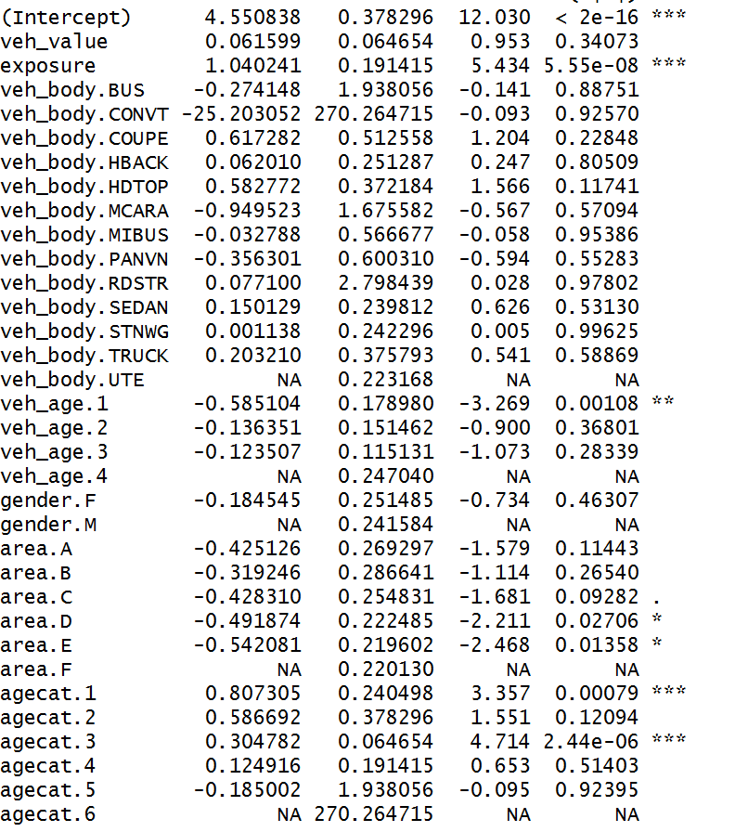
Appendix: Initial variables analysis

